Slide 1
Educate, Conserve, Optimize, Cycle, Yield, Clean, Live, Earth
EcoCycle
Reduce, Reuse, Revolutionize

Slide 2
The Need for Sustainability
Climate change affects global health and economies.
40% of municipal waste ends up in landfills
01
02
03
Resource conservation is crucial for future generations
04
Community engagement drives behavioral change

Slide 3
What is EcoCycle?
EcoCycle is a user-friendly web app designed to educate, engage, and empower campus communities to adopt sustainable practices, reduce waste, and conserve resources.

Slide 4




Why EcoCycle Matters
Reduced greenhouse gas emissions
Community engagement and social responsibility
Enhanced campus resilience to climate risks
Cost savings through resource conservation
Improved campus image and reputation

Slide 5




Empowering Sustainability
Personalized Sustainability
Educational Resources and Workshops
Tracking: Monitor progress, set goals
Learn sustainable practices
Gamification and Rewards
Social Sharing & Community Engagement
Earn points, badges, and prizes
Share eco-achievements, collaborate
Local Resource Directories
Find eco-friendly services, products

Slide 6
Educational Resources and Workshops
Educate & Engage
Visual Learning Tools:
Eco-Facts Infographics: Bite-sized visuals highlighting recycling, composting, and waste reduction essentials.
Impact Insights: Graphics illustrating the environmental footprint of various materials and their decomposition rates.

Slide 7
Educational Resources and Workshops
Educate & Engage
Interactive Experiences:
Sustainability Quizzes: Engaging tests assessing users' knowledge, with instant feedback.
Eco-Challenges: Gamified tasks promoting sustainable practices, earning points and badges.
Users can interact by liking and/or commenting on each other’s posts.

Slide 8
Educational Resources and Workshops
Educate & Engage
Personalized Notifications
Event Alerts: Timely reminders about workshops, challenges, and events.
Eco-Tips & Facts: Regular push notifications sharing recycling and sustainability insights.

Slide 9
Educational Resources and Workshops
Educate & Engage
Digital Campus Eco-Tour
Interactive map pinpointing recycling bins, composting stations, and waste collection points across campus.
Identifying areas showcasing sustainable practices and innovative solutions.

Slide 10
Educational Resources and Workshops
Workshops & Events
Community Engagement
Masterclasses: Expert-led sessions on sustainability topics.
Workshops: Hands-on training in creative reuse and recycling.

Slide 11
Gamification and Rewards
1. Challenge System:
Sustainability Challenge: Choose from pre-designed challenges or craft your own to inspire eco-friendly competition. Select from options like 'Waste Reduction Warrior' or 'Energy Efficiency Champion', or customize your challenge with unique tasks, timelines, and rules.
Invitations can be sent through the EcoCycle app or via any preferred channel like email, social media and messaging apps.

Slide 12
Gamification and Rewards
2. Progress Tracking & Updates:
Live Challenge Dashboard: Showcase a mini leaderboard highlighting:
Current leader
Top performers
Lead margin
Real-Time Updates: Send push notifications and in-app alerts to keep participants engaged, featuring:
Progress updates (e.g., "You're pulling ahead!")
Opponent milestones (e.g., "Your rival just scored 10 points!")
Challenge reminders

Slide 13
Gamification and Rewards
3. Challenge Parameters:
Timeframe: Select duration (e.g., day, week, month) with mutual agreement
Challenge Criteria: Establish rules for counted actions (e.g., sustainable commuting, waste reduction)
App monitors and updates progress in real-time

Slide 14
Gamification and Rewards
4. Recognize & Reward Integrity:
Encourage users to demonstrate genuine achievements by offering rewards or acknowledgement for-
Consistent honesty
Verified accomplishments
Transparent progress
Earn the Verified Achiever badge by-
Providing valid, verified achievements
Demonstrating consistent integrity
Maintaining transparency

Slide 15
Gamification and Rewards
4. Recognize & Reward Integrity:
Benefits of Verified Achiever Status-
Enhanced credibility within the community
Increased influence and reputation
Exclusive access to premium features/resources
Leadership opportunities
Disincentives for Dishonesty-
Lose points, badges
Lose access to certain features
Repeat offenders will be banned from the platform

Slide 16
Awards
Eco-Hero Levels:
Bronze: Participate in basic recycling programs (paper, plastic, glass)
Silver: Recycle specialized materials (electronics, batteries, textiles)
Gold: Recycle heavy or bulk items (wood, metals, appliances)
Platinum: Achieve significant waste reduction through creative reuse and repurposing

Slide 17
Awards
Eco-Achievement Tiers:
Recycling Rookie: Properly dispose of hazardous waste (chemicals, medicines etc.)
Recycling Renegade: Recycle electronics, batteries, textiles
Recycling Ranger: Recycle heavy or bulk items (wood, metals, appliances)
Recycling Rainmaker: Implement innovative waste reduction strategies (zero-waste events, community composting)

Slide 18
Awards
Eco-Echelons:
Conservation Champion: Reduce energy consumption by 20%
Waste Warrior: Recycle 90% of hostel waste
Sustainability Superstar: Implement a zero-waste policy on the campus
Environmental Leader: Develop and promote community-wide sustainability initiatives

Slide 19
Waste Reduction & Recycling
Waste material found on college campus
Paper
Cardboard
Thermocol (polystyrene)
Glass bottles
Laboratory glassware
Light bulbs
Cosmetics
Chemicals
Paints
Medicines
Wood scraps
Ceramic and Tiles
Scrap metal
Electronics
Batteries

Slide 20
Waste Reduction & Recycling
HOW?
On-Campus Processing- Composting ​
Establish an on-campus composting facility to process organic waste from:
Dining halls (food waste)
Landscape maintenance (yard trimmings, leaves)
Advantages:
Convert organic waste into nutrient-rich compost
Utilize compost in campus gardens and landscaping projects
Reduce greenhouse gas emissions from waste transportation
Enhance campus sustainability and educational opportunities
Close the loop on organic waste management

Slide 21
Waste Reduction & Recycling
On-Campus Processing- Recycling Sorting Center ​
Establish a centralized on-campus Recycling Sorting Hub to ensure accurate separation of recyclables, fostering a closed-loop system. This facility will also provide hands-on learning opportunities for students.
Advantages:
Centralized sorting facility
Accurate separation of recyclables
Student employment opportunities
Hands-on learning experience
Sustainability education

Slide 22
Waste Reduction & Recycling
Waste Reduction Strategies​
Reduction Campaigns:​
Reusable containers and bags
Reduced single-use items
Digital documentation and paperless processes
Sustainable practices and behaviors

Slide 23
Waste Reduction & Recycling
Waste Reduction Strategies​
Reuse and Repurpose Programs:
Donate used items
Swap or exchange items no longer needed
Bring clothing, electronics, and other items for repair or exchange
Learn DIY repair skills and sustainable consumption practices
Engage with peers and promote community reuse

Slide 24
Waste Reduction & Recycling
Monitoring and Reporting ​
Track and Optimize Waste Management
Utilize digital tools and smart bin technology to monitor waste volumes and composition.
Conduct regular waste audits to identify areas for improvement and contamination reduction.
Feedback and Continuous Improvement
Establish a feedback system for students and staff to report waste disposal issues (e.g., overflowing bins, unclear signage).
Use feedback to implement data-driven improvements to the waste management system.

Slide 25
Waste Reduction & Recycling
Monitoring and Reporting ​
Transparency and Accountability
Publish regular reports highlighting waste management successes, challenges, and areas for improvement.
Foster a culture of accountability and continuous improvement through education and community engagement.

Slide 26
Waste Reduction & Recycling
Efficient Waste Transportation Logistics-
Vehicle & Route Optimization
​
Utilize designated campus vehicles for waste collection, maintaining separate transportation for different waste streams to prevent cross-contamination.
Implement a sophisticated route planning system to streamline waste collection, minimizing:
Costs
Emissions
Environmental footprint

Slide 27
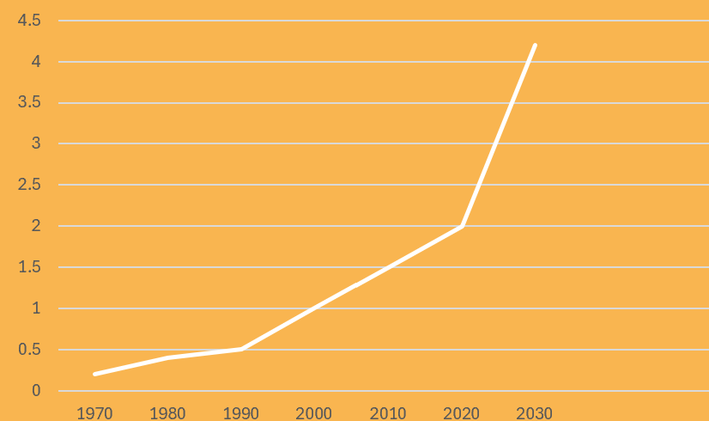
Resource Conservation: A Necessary Step
Graph of:
India’s Total Material Consumption (in tonnes)
Vs
The Year
Projected Demand:
2040: 6.5b tonnes
2050: 9.0 tonnes

Slide 28
Bridging the Resource Gap
Increasing demand, decreasing supply: a looming crisis.
EcoCycle offers innovative solutions for conserving water, energy, and minerals.

Slide 29
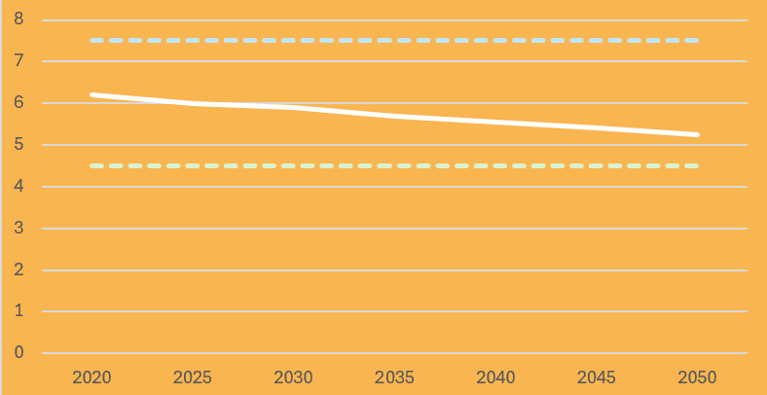



Case Study: Costs
Graph of: INR/kWh
Vs
The Year
The graph shows a steady decline in the cost of renewable power, compared to the stark difference of the coal-based power costs.
(Source-McKinsey)
Renewable Energy Cost
Coal-based power cost (Max)
Coal-based power cost (Min)

Slide 30
Cut Costs with EcoCycle
EcoCycle:
Simplifies recycling processes
Reduces waste
Automates routine tasks
Enhances efficiency
Saves money

Slide 31
Our Goals
30 %
60 %
75 %
Reduce campus waste generation by 20-30%
Increase recycling rate to 60%
Promote sustainable practices among 75% of the campus population
15 %
15% reduction in campus energy consumption

Slide 32
20-30% Waste Reduction
The 30% waste reduction target is a realistic and achievable goal based on similar campus sustainability initiatives, viz:
IIT Bombay: 30% waste reduction through composting and recycling programs
IIT Madras: 20% waste reduction through waste management and recycling programs
IIM Ahmedabad: 25% waste reduction through waste segregation and recycling
University of Delhi: 22% waste reduction through composting and recycling initiatives (Source: University of Delhi Sustainability)

Slide 33
60% Recycling Rate
Similar campuses have achieved 50-70% recycling rates, viz:
IIT Bombay: 58% recycling rate
IIT Madras: 60% recycling rate
IIM Ahmedabad: 55% recycling rate
University of Delhi: 52% recycling rate

Slide 34
15% Reduction in Energy Consumption
10-15% is a realistic target, considering typical energy usage patterns
A 10-15% reduction can significantly lower greenhouse gas emissions.

Slide 35
15% Reduction in Energy Consumption
Similar campuses have achieved 50-70% recycling rates, viz
IIT Bombay- Reduced energy consumption by 12% through:
LED lighting retrofitting
Energy-efficient HVAC systems
Solar power generation (2 MW)
Savings: ₹1.5 crore

Slide 36
15% Reduction in Energy Consumption
IISc Bangalore- Reduced energy consumption by 10% through:
Energy-efficient laboratory equipment
LED lighting retrofitting
Energy management system (EMS) implementation
Savings: ₹1.2 crore

Slide 37
15% Reduction in Energy Consumption
Delhi University- Achieved 15% energy reduction through:
Energy-efficient lighting and HVAC systems
Solar power generation (1.5 MW)
Energy auditing and monitoring
Savings: ₹2.5 crore

Slide 38
15% Reduction in Energy Consumption
TISS Mumbai- Achieved 12% energy reduction through:
Solar power generation (500 kW)
Energy-efficient lighting and HVAC systems
Rainwater harvesting and greywater reuse
Savings: ₹1.8 crore

Slide 39
SOURCES
sustainability@iitb.ac.in
sustainability@iitm.ac.in
sustainability@iima.ac.in
sustainability@du.ac.in
sustainability@banasthali.org
https://cst.iisc.ac.in/cst/
https://www.tiss.edu/view/6/mumbai-campus/school-of-habitat-studies-2/centre-for-climate-change/about-centre/

Slide 40
RISKS INVOLVED
…and how EcoCycle tackles them.

Slide 41
01
Users lying about minor achievements by faking tasks

Slide 42
SOLUTION:
Random audits of user achievements. Notify users that their submissions may be subject to random verification to encourage honesty.​
Users must upload photo/ video proof of them completing tasks.
Timestamps and geolocation data from photos and videos to ensure authenticity
Peer verification system where other users can confirm or endorse the achievements of their peers.
Certain achievements require approval or validation from multiple users before they are officially recognized.​

Slide 43
02
Users lying about major achievements by faking tasks

Slide 44
Solution:
Algorithms to flag unusual or potentially fraudulent activity for review, such as a sudden spike in high-impact achievements from a single user.
An admin review process for high-impact achievements or those tied to significant rewards. This involves a dedicated team or committee that reviews and verifies submissions before they are approved.​
AI analyses patterns and detects potential fraud. ML algorithms can flag suspicious behaviour, such as patterns that don’t align with typical user activity.​
AI cross-checks user-submitted evidence against known benchmarks or patterns, helping to identify inconsistencies.​

Slide 45
03
Server Glitch Resulting in Data Loss

Slide 46
Solution:
Blockchain's decentralized storage facilitates data recovery.
Regular backups (e.g., daily, weekly, monthly)
Cloud-to-on-premises backup
Backups stored in different geographic regions

Slide 47
"The future of our planet depends on what each of us does every day."
- John Kerry

Slide 48
END OF PROBLEM STATEMENT DESCRIPTION

Slide 49
UI/UX

Slide 50
TECH-STACK
UI/UX: Figma
DSA: MySQL
Back-end: Python, JS

Slide 51
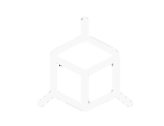
BLOCKCHAIN (Web3)
Tamper-proof storage of user achievements.
Transparent verification and validation.
Cryptographic algorithms ensure secure data storage.
Secure data replenishment in case of loss or corruption.

Slide 52
AI/ML
Data Collection
User-submitted evidence (aka photos, videos)
Known benchmarks and patterns
Preprocess Data
Clean and normalize data
Handle missing values

Slide 53
ML Model Selection, Training & Deployment
Unsupervised learning → Anomaly Detection
Train ML models using selected algorithms
Evaluate model performance:
Accuracy
Precision
Recall
F1-score
Deploy trained models:
Integrate with existing systems
Use APIs or web services

Slide 54
AI-powered Fraud Detection
Implement pattern recognition:
Identify unusual patterns in user activity
Detect anomalies in transaction data
Cross-check user-submitted evidence:
Compare against known benchmarks
Identify inconsistencies
Flag suspicious behavior:
Alert systems or human reviewers

